Slide 1
Algorithms
Gabriel Istrate, West University of Timișoara.
Course 6: Sorting algorithms: Quicksort, Heapsort, Lower bounds.
Slide credit: David Luebke (Virginia)

Slide 2
Quicksort
Sorts in place
Sorts O(n lg n) in the average case
Sorts O(n²) in the worst case
  But in practice, it’s quick
  And the worst case doesn’t happen often (but more on this later…)

Slide 3
Quicksort
Another divide-and-conquer algorithm
  The array A[p..r] is partitioned into two non-empty subarrays A[p..q] and A[q+1..r]
    Invariant: All elements in A[p..q] are less than all elements in A[q+1..r]
  The subarrays are recursively sorted by calls to quicksort
  Unlike merge sort, no combining step: two subarrays form an already-sorted array

Slide 4
Quicksort Code
Quicksort(A, p, r)
{
if (p < r)
{
q = Partition(A, p, r);
Quicksort(A, p, q);
Quicksort(A, q+1, r);
}
}

Slide 5
Partition
Clearly, all the action takes place in the partition() function
  Rearranges the subarray in place
  End result:
    Two subarrays
    All values in first subarray ≤ all values in second
  Returns the index of the “pivot” element separating the two subarrays
How do you suppose we implement this?

Slide 6
Partition In Words
Partition(A, p, r):
  Select an element to act as the “pivot” (which?)
  Grow two regions, A[p..i] and A[j..r]
    All elements in A[p..i] <= pivot
    All elements in A[j..r] >= pivot
  Increment i until A[i] >= pivot
  Decrement j until A[j] <= pivot
  Swap A[i] and A[j]
  Repeat until i >= j
  Return j

Slide 7
Partition Code
Partition(A, p, r)
x = A[p];
i = p - 1;
j = r + 1;
while (TRUE)
repeat
j--;
until A[j] <= x;
repeat
i++;
until A[i] >= x;
if (i < j)
Swap(A, i, j);
else
return j;
Illustrate on
A = {5, 3, 2, 6, 4, 1, 3, 7};
What is the running time of partition()?

Slide 8
Partition Code
Partition(A, p, r)
x = A[p];
i = p - 1;
j = r + 1;
while (TRUE)
repeat
j--;
until A[j] <= x;
repeat
i++;
until A[i] >= x;
if (i < j)
Swap(A, i, j);
else
return j;
partition() runs in O(n) time

Slide 9
Analyzing Quicksort
What will be the worst case for the algorithm?
  Partition is always unbalanced
What will be the best case for the algorithm?
  Partition is perfectly balanced
Which is more likely?
  The latter, by far, except...
Will any particular input elicit the worst case?
  Yes: Already-sorted input

Slide 10
Analyzing Quicksort
In the worst case:
  T(1) = Θ(1)
  T(n) = T(n - 1) + Θ(n)
Works out to
T(n) = Θ(n²)

Slide 11
Analyzing Quicksort
In the best case:
  T(n) = 2T(n/2) + Θ(n)
What does this work out to?
  T(n) = Θ(n lg n)

Slide 12
Improving Quicksort
The real liability of quicksort is that it runs in O(n²) on already-sorted input
Solutions:
  Randomize the input array, OR
  Pick a random pivot element, OR
  Choose the pivot wisely (median)
How will these solve the problem?
  By insuring that no particular input can be chosen to make quicksort run in O(n²) time

Slide 13
Analyzing Quicksort: Average Case
Assuming random input, average-case running time is much closer to O(n lg n) than O(n²)
First, a more intuitive explanation/example:
  Suppose that partition() always produces a 9-to-1 split. This looks quite unbalanced!
  The recurrence is thus:
  T(n) = T(9n/10) + T(n/10) + n
  How deep will the recursion go? (draw it)
Use n instead of O(n)
for convenience (how?)

Slide 14
Analyzing Quicksort: Average Case
Intuitively, a real-life run of quicksort will produce a mix of “bad” and “good” splits
  Randomly distributed among the recursion tree
  Pretend for intuition that they alternate between best-case (n/2 : n/2) and worst-case (n-1 : 1)
  What happens if we bad-split root node, then good-split the resulting size (n-1) node?

Slide 15
Analyzing Quicksort: Average Case
Intuitively, a real-life run of quicksort will produce a mix of “bad” and “good” splits
  Randomly distributed among the recursion tree
  Pretend for intuition that they alternate between best-case (n/2 : n/2) and worst-case (n-1 : 1)
  What happens if we bad-split root node, then good-split the resulting size (n-1) node?
    We end up with three subarrays, size 1, (n-1)/2, (n-1)/2
    Combined cost of splits = n + n -1 = 2n -1 = O(n)
    No worse than if we had good-split the root node!

Slide 16
Analyzing Quicksort: Average Case
Intuitively, the O(n) cost of a bad split
(or 2 or 3 bad splits) can be absorbed
into the O(n) cost of each good split
Thus running time of alternating bad and good splits is still O(n lg n), with slightly higher constants
How can we be more rigorous?

Slide 17
Analyzing Quicksort: Average Case
For simplicity, assume:
  All inputs distinct (no repeats)
  Slightly different partition() procedure
    partition around a random element, which is not included in subarrays
    all splits (0:n-1, 1:n-2, 2:n-3, … , n-1:0) equally likely
What is the probability of a particular split happening?
Answer: 1/n

Slide 18
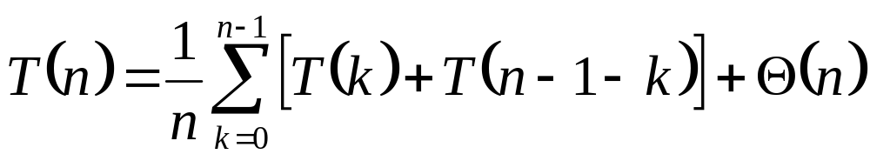
Analyzing Quicksort: Average Case
So partition generates splits
(0:n-1, 1:n-2, 2:n-3, … , n-2:1, n-1:0)
each with probability 1/n
If T(n) is the expected running time,
What is each term under the summation for?
What is the Θ(n) term for?

Slide 19
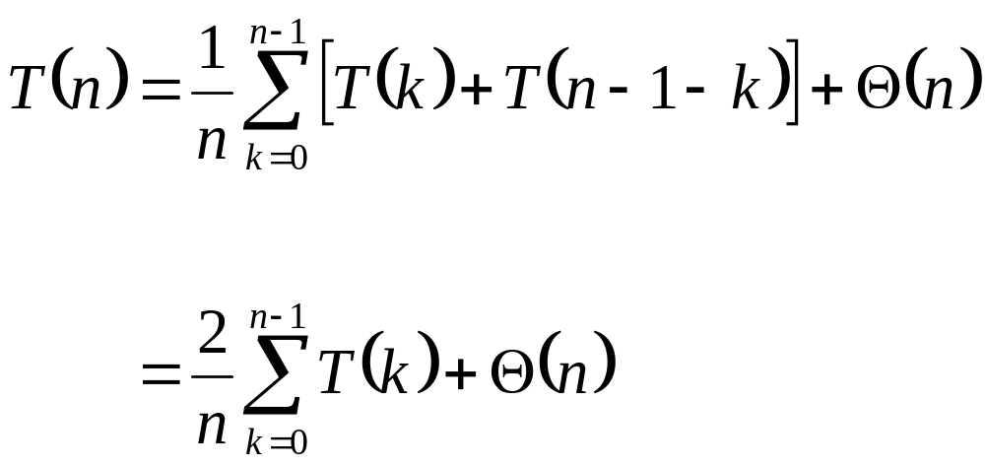
Analyzing Quicksort: Average Case
So…
  We’ll take care of that in a second
Write it on
the board

Slide 20
Analyzing Quicksort: Average Case
We can solve this recurrence using the dreaded substitution method
  Guess the answer
  Assume that the inductive hypothesis holds
  Substitute it in for some value < n
  Prove that it follows for n

Slide 21
Analyzing Quicksort: Average Case
We can solve this recurrence using the dreaded substitution method
  Guess the answer
    What’s the answer?
  Assume that the inductive hypothesis holds
  Substitute it in for some value < n
  Prove that it follows for n

Slide 22
Analyzing Quicksort: Average Case
We can solve this recurrence using the dreaded substitution method
  Guess the answer
    T(n) = O(n lg n)
  Assume that the inductive hypothesis holds
  Substitute it in for some value < n
  Prove that it follows for n

Slide 23
Analyzing Quicksort: Average Case
We can solve this recurrence using the dreaded substitution method
  Guess the answer
    T(n) = O(n lg n)
  Assume that the inductive hypothesis holds
    What’s the inductive hypothesis?
  Substitute it in for some value < n
  Prove that it follows for n

Slide 24
Analyzing Quicksort: Average Case
We can solve this recurrence using the dreaded substitution method
  Guess the answer
    T(n) = O(n lg n)
  Assume that the inductive hypothesis holds
    T(n) ≤ an lg n + b for some constants a and b
  Substitute it in for some value < n
  Prove that it follows for n

Slide 25
Analyzing Quicksort: Average Case
We can solve this recurrence using the dreaded substitution method
  Guess the answer
    T(n) = O(n lg n)
  Assume that the inductive hypothesis holds
    T(n) ≤ an lg n + b for some constants a and b
  Substitute it in for some value < n
    What value?
  Prove that it follows for n

Slide 26
Analyzing Quicksort: Average Case
We can solve this recurrence using the dreaded substitution method
  Guess the answer
    T(n) = O(n lg n)
  Assume that the inductive hypothesis holds
    T(n) ≤ an lg n + b for some constants a and b
  Substitute it in for some value < n
    The value k in the recurrence
  Prove that it follows for n

Slide 27
Analyzing Quicksort: Average Case
We can solve this recurrence using the dreaded substitution method
  Guess the answer
    T(n) = O(n lg n)
  Assume that the inductive hypothesis holds
    T(n) ≤ an lg n + b for some constants a and b
  Substitute it in for some value < n
    The value k in the recurrence
  Prove that it follows for n
    Grind through it…

Slide 28
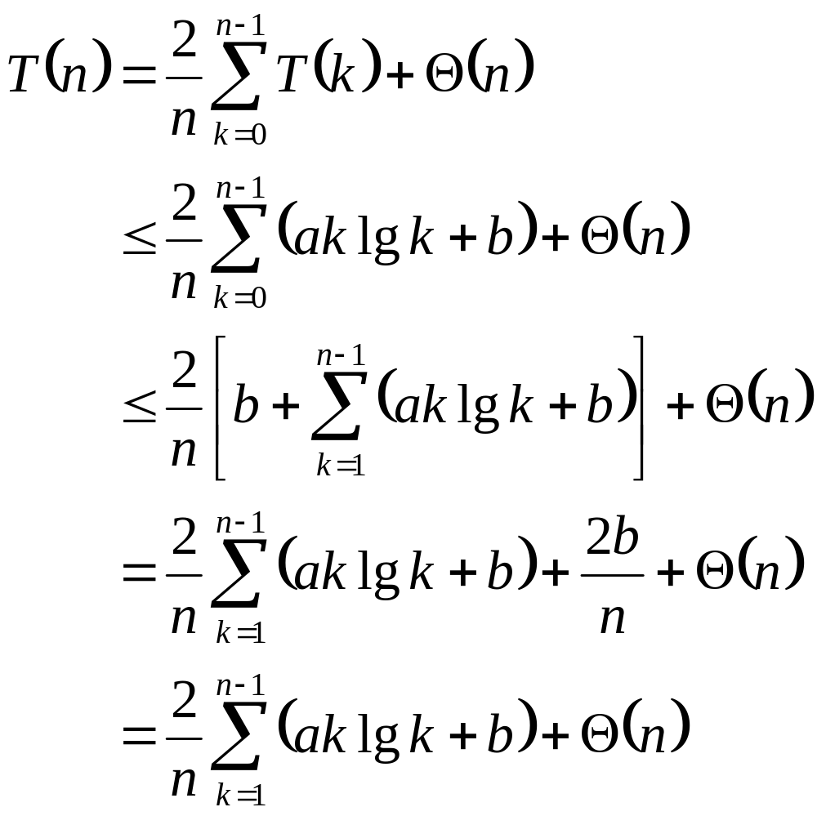
Analyzing Quicksort: Average Case
The recurrence to be solved
Plug in inductive hypothesis
What are we doing here?
Expand out the k=0 case
What are we doing here?
2b/n is just a constant,
so fold it into Θ(n)
What are we doing here?

Slide 29
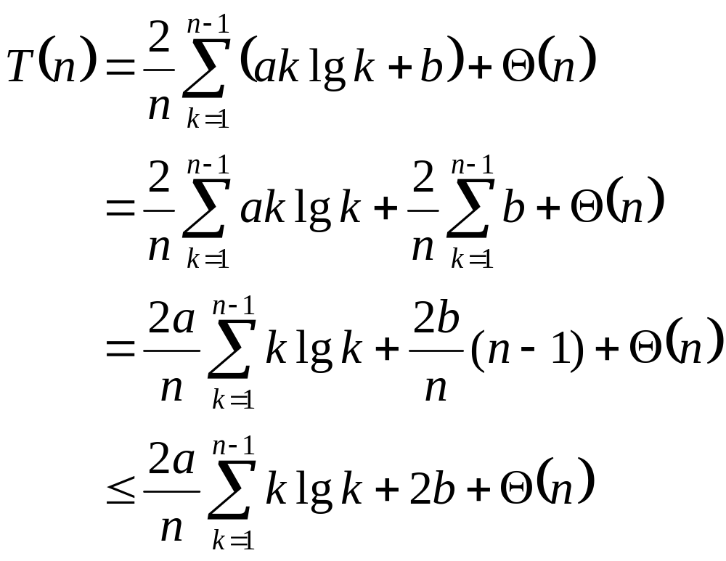
Analyzing Quicksort: Average Case
The recurrence to be solved
Distribute the summation
What are we doing here?
Evaluate the summation:
b+b+…+b = b (n-1)
What are we doing here?
Since n-1<n, 2b(n-1)/n < 2b
What are we doing here?
This summation gets its own set of slides later

Slide 30
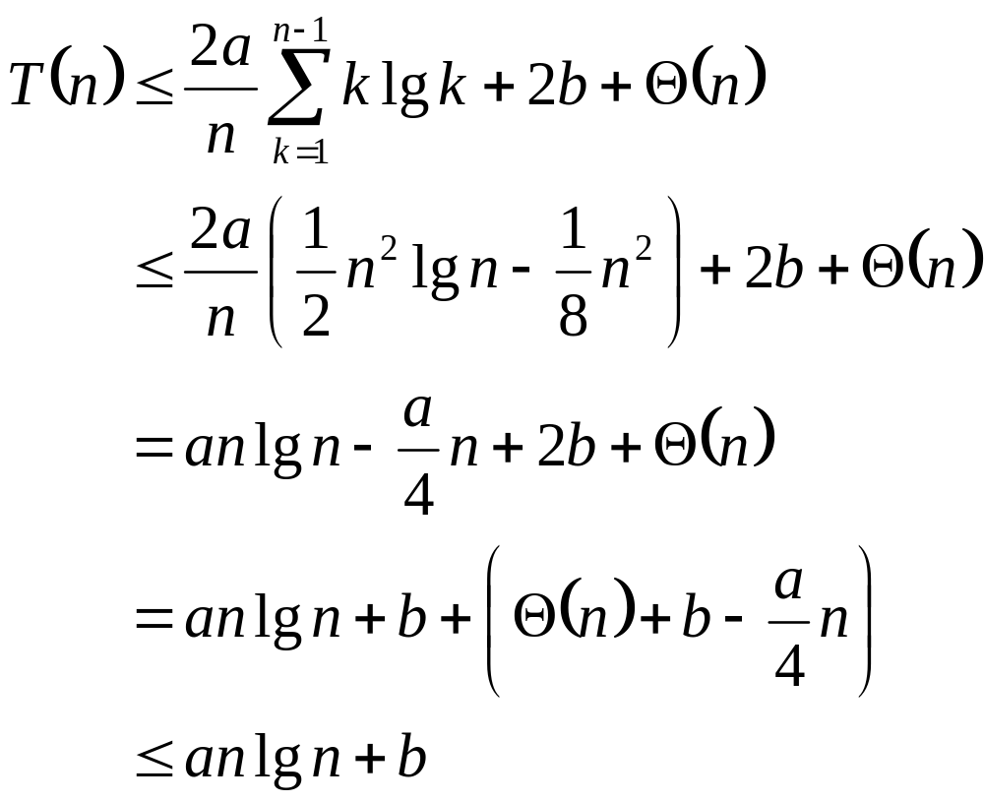
Analyzing Quicksort: Average Case
The recurrence to be solved
We’ll prove this later
What the hell?
Distribute the (2a/n) term
What are we doing here?
Remember, our goal is to get T(n) ≤ an lg n + b
What are we doing here?
Pick a large enough that
an/4 dominates Θ(n)+b
How did we do this?

Slide 31
Analyzing Quicksort: Average Case
So T(n) ≤ an lg n + b for certain a and b
  Thus the induction holds
  Thus T(n) = O(n lg n)
  Thus quicksort runs in O(n lg n) time on average (phew!)
Oh yeah, the summation…

Slide 32
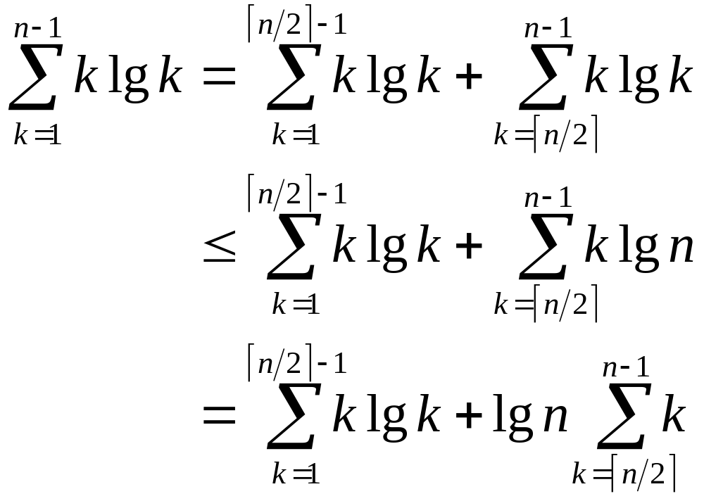
Tightly Bounding
The Key Summation
Split the summation for a tighter bound
What are we doing here?
The lg k in the second term is bounded by lg n
What are we doing here?
Move the lg n outside the summation
What are we doing here?

Slide 33
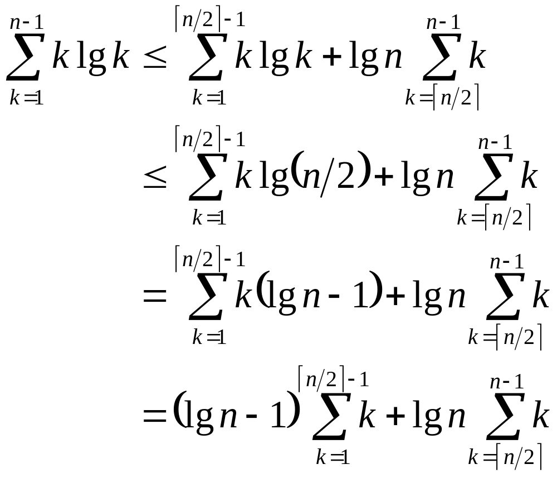
Tightly Bounding
The Key Summation
The summation bound so far
The lg k in the first term is bounded by lg n/2
What are we doing here?
lg n/2 = lg n - 1
What are we doing here?
Move (lg n - 1) outside the summation
What are we doing here?

Slide 34
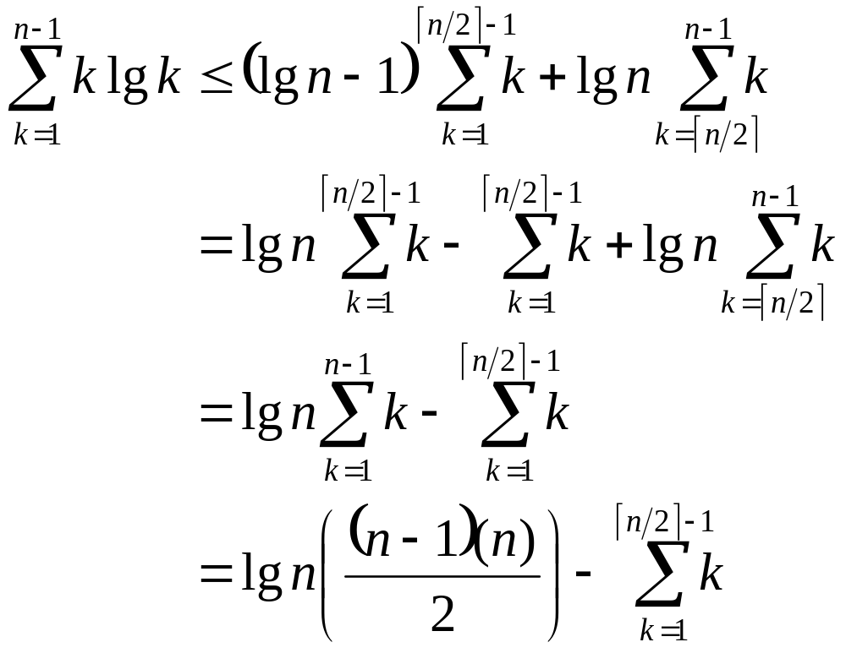
Tightly Bounding
The Key Summation
The summation bound so far
Distribute the (lg n - 1)
What are we doing here?
The summations overlap in range; combine them
What are we doing here?
The Gaussian series
What are we doing here?

Slide 35
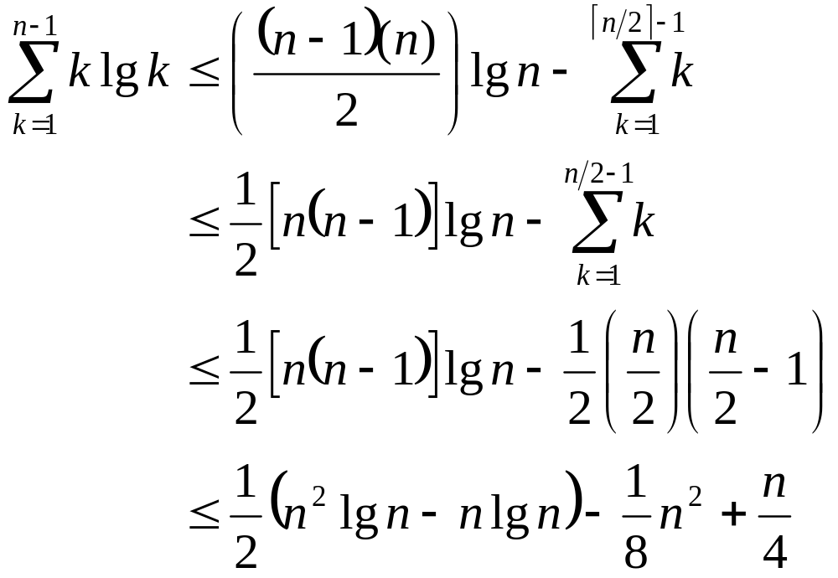
Tightly Bounding
The Key Summation
The summation bound so far
Rearrange first term, place upper bound on second
What are we doing here?
X Gaussian series
What are we doing?
Multiply it
all out
What are we doing?

Slide 36
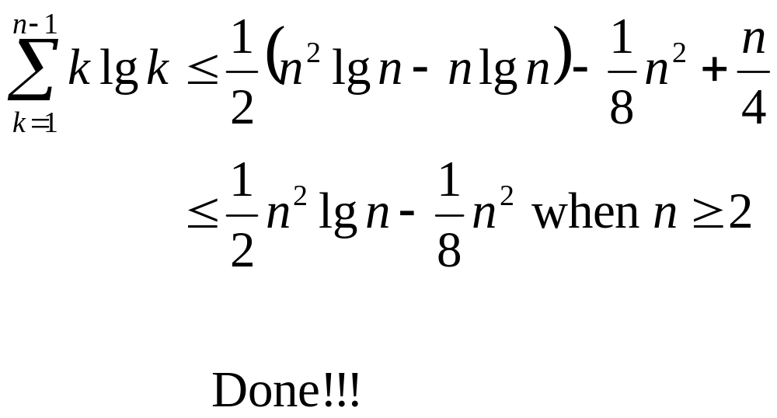
Tightly Bounding
The Key Summation

Slide 37
Sorting Revisited
So far we’ve talked about two algorithms to sort an array of numbers
  What is the advantage of merge sort?
  What is the advantage of insertion sort?
Next on the agenda: Heapsort
  Combines advantages of both previous algorithms

Slide 38
Heaps
A heap can be seen as a complete binary tree:
  What makes a binary tree complete?
  Is the example above complete?
16
14
10
8
7
9
3
2
4
1

Slide 39
Heaps
A heap can be seen as a complete binary tree:
  The book calls them “nearly complete” binary trees; can think of unfilled slots as null pointers
16
14
10
8
7
9
3
2
4
1
1
1
1
1
1

Slide 40
Heaps
In practice, heaps are usually implemented as arrays:
16
14
10
A =
16
14
10
8
7
9
3
2
4
1
=
8
7
9
3
2
4
1

Slide 41
Heaps
To represent a complete binary tree as an array:
  The root node is A[1]
  Node i is A[i]
  The parent of node i is A[i/2] (note: integer divide)
  The left child of node i is A[2i]
  The right child of node i is A[2i + 1]
16
14
10
A =
16
14
10
8
7
9
3
2
4
1
=
8
7
9
3
2
4
1

Slide 42
Referencing Heap Elements
So…
  Parent(i) { return ⎣i/2⎦; }
  Left(i) { return 2*i; }
  right(i) { return 2*i + 1; }
An aside: How would you implement this
most efficiently?
Another aside: Really?

Slide 43
The Heap Property
Heaps also satisfy the heap property:
A[Parent(i)] ≥ A[i] for all nodes i > 1
  In other words, the value of a node is at most the value of its parent
  Where is the largest element in a heap stored?
Definitions:
  The height of a node in the tree = the number of edges on the longest downward path to a leaf
  The height of a tree = the height of its root

Slide 44
Heap Height
What is the height of an n-element heap? Why?
This is nice: basic heap operations take at most time proportional to the height of the heap

Slide 45
Heap Operations: Heapify()
Heapify(): maintain the heap property
  Given: a node i in the heap with children l and r
  Given: two subtrees rooted at l and r, assumed to be heaps
  Problem: The subtree rooted at i may violate the heap property (How?)
  Action: let the value of the parent node “float down” so subtree at i satisfies the heap property
    What do you suppose will be the basic operation between i, l, and r?

Slide 46
Heap Operations: Heapify()
Heapify(A, i)
{
l = Left(i); r = Right(i);
if (l <= heap_size(A) && A[l] > A[i])
largest = l;
else
largest = i;
if (r <= heap_size(A) && A[r] > A[largest])
largest = r;
if (largest != i)
Swap(A, i, largest);
Heapify(A, largest);
}

Slide 47
Heapify() Example
16
4
10
14
7
9
3
2
8
1
A =
16
4
10
14
7
9
3
2
8
1

Slide 48
Heapify() Example
16
4
10
14
7
9
3
2
8
1
A =
16
4
10
14
7
9
3
2
8
1

Slide 49
Heapify() Example
16
4
10
14
7
9
3
2
8
1
A =
16
4
10
14
7
9
3
2
8
1

Slide 50
Heapify() Example
16
14
10
4
7
9
3
2
8
1
A =
16
14
10
4
7
9
3
2
8
1

Slide 51
Heapify() Example
16
14
10
4
7
9
3
2
8
1
A =
16
14
10
4
7
9
3
2
8
1

Slide 52
Heapify() Example
16
14
10
4
7
9
3
2
8
1
A =
16
14
10
4
7
9
3
2
8
1

Slide 53
Heapify() Example
16
14
10
8
7
9
3
2
4
1
A =
16
14
10
8
7
9
3
2
4
1

Slide 54
Heapify() Example
16
14
10
8
7
9
3
2
4
1
A =
16
14
10
8
7
9
3
2
4
1

Slide 55
Heapify() Example
16
14
10
8
7
9
3
2
4
1
A =
16
14
10
8
7
9
3
2
4
1

Slide 56
Analyzing Heapify(): Informal
Aside from the recursive call, what is the running time of Heapify()?
How many times can Heapify() recursively call itself?
What is the worst-case running time of Heapify() on a heap of size n?

Slide 57
Analyzing Heapify(): Formal
Fixing up relationships between i, l, and r takes Θ(1) time
If the heap at i has n elements, how many elements can the subtrees at l or r have?
  Draw it
Answer: 2n/3 (worst case: bottom row 1/2 full)
So time taken by Heapify() is given by
T(n) ≤ T(2n/3) + Θ(1)

Slide 58
Analyzing Heapify(): Formal
So we have
T(n) ≤ T(2n/3) + Θ(1)
By case 2 of the Master Theorem,
T(n) = O(lg n)
Thus, Heapify() takes linear time

Slide 59
Heap Operations: BuildHeap()
We can build a heap in a bottom-up manner by running Heapify() on successive subarrays
  Fact: for array of length n, all elements in range
  A[⎣n/2⎦ + 1 .. n] are heaps (Why?)
  So:
    Walk backwards through the array from n/2 to 1, calling Heapify() on each node.
    Order of processing guarantees that the children of node i are heaps when i is processed

Slide 60
BuildHeap()
// given an unsorted array A, make A a heap
BuildHeap(A)
{
heap_size(A) = length(A);
for (i = ⎣length[A]/2⎦ downto 1)
Heapify(A, i);
}

Slide 61
BuildHeap() Example
Work through example
A = {4, 1, 3, 2, 16, 9, 10, 14, 8, 7}
4
1
3
2
16
9
10
14
8
7

Slide 62
Analyzing BuildHeap()
Each call to Heapify() takes O(lg n) time
There are O(n) such calls (specifically, ⎣n/2⎦)
Thus the running time is O(n lg n)
  Is this a correct asymptotic upper bound?
  Is this an asymptotically tight bound?
A tighter bound is O(n)
  How can this be? Is there a flaw in the above reasoning?

Slide 63
Analyzing BuildHeap(): Tight
To Heapify() a subtree takes O(h) time where h is the height of the subtree
  h = O(lg m), m = # nodes in subtree
  The height of most subtrees is small
Fact: an n-element heap has at most ⎡n/2^{h+1}⎤ nodes of height h
CLR 7.3 uses this fact to prove that BuildHeap() takes O(n) time

Slide 64
Heapsort
Given BuildHeap(), an in-place sorting algorithm is easily constructed:
  Maximum element is at A[1]
  Discard by swapping with element at A[n]
    Decrement heap_size[A]
    A[n] now contains correct value
  Restore heap property at A[1] by calling Heapify()
  Repeat, always swapping A[1] for A[heap_size(A)]

Slide 65
Heapsort
Heapsort(A)
{
BuildHeap(A);
for (i = length(A) downto 2)
{
Swap(A[1], A[i]);
heap_size(A) -= 1;
Heapify(A, 1);
}
}

Slide 66
Analyzing Heapsort
The call to BuildHeap() takes O(n) time
Each of the n - 1 calls to Heapify() takes O(lg n) time
Thus the total time taken by HeapSort()
= O(n) + (n - 1) O(lg n)
= O(n) + O(n lg n)
= O(n lg n)

Slide 67
Priority Queues
Heapsort is a nice algorithm, but in practice Quicksort (coming up) usually wins
But the heap data structure is incredibly useful for implementing priority queues
  A data structure for maintaining a set S of elements, each with an associated value or key
  Supports the operations Insert(), Maximum(), and ExtractMax()
  What might a priority queue be useful for?

Slide 68
Priority Queue Operations
Insert(S, x) inserts the element x into set S
Maximum(S) returns the element of S with the maximum key
ExtractMax(S) removes and returns the element of S with the maximum key
How could we implement these operations using a heap?

Slide 69
Sorting So Far
Insertion sort:
  Easy to code
  Fast on small inputs (less than ~50 elements)
  Fast on nearly-sorted inputs
  O(n²) worst case
  O(n²) average (equally-likely inputs) case
  O(n²) reverse-sorted case

Slide 70
Sorting So Far
Merge sort:
  Divide-and-conquer:
    Split array in half
    Recursively sort subarrays
    Linear-time merge step
  O(n lg n) worst case
  Doesn’t sort in place

Slide 71
Sorting So Far
Heap sort:
  Uses the very useful heap data structure
    Complete binary tree
    Heap property: parent key > children’s keys
  O(n lg n) worst case
  Sorts in place
  Fair amount of shuffling memory around

Slide 72
Sorting So Far
Quick sort:
  Divide-and-conquer:
    Partition array into two subarrays, recursively sort
    All of first subarray < all of second subarray
    No merge step needed!
  O(n lg n) average case
  Fast in practice
  O(n²) worst case
    Naïve implementation: worst case on sorted input
    Address this with randomized quicksort

Slide 73
How Fast Can We Sort?
We will provide a lower bound, then beat it
  How do you suppose we’ll beat it?
First, an observation: all of the sorting algorithms so far are comparison sorts
  The only operation used to gain ordering information about a sequence is the pairwise comparison of two elements
  Theorem: all comparison sorts are Ω(n lg n)
    A comparison sort must do O(n) comparisons (why?)
    What about the gap between O(n) and O(n lg n)

Slide 74
Decision Trees
Decision trees provide an abstraction of comparison sorts
  A decision tree represents the comparisons made by a comparison sort. Every thing else ignored
  (Draw examples on board)
What do the leaves represent?
How many leaves must there be?

Slide 75
Decision Trees
Decision trees can model comparison sorts. For a given algorithm:
  One tree for each n
  Tree paths are all possible execution traces
  What’s the longest path in a decision tree for insertion sort? For merge sort?
What is the asymptotic height of any decision tree for sorting n elements?
Answer: Ω(n lg n) (now let’s prove it…)

Slide 76
Lower Bound For
Comparison Sorting
Thm: Any decision tree that sorts n elements has height Ω(n lg n)
What’s the minimum # of leaves?
What’s the maximum # of leaves of a binary tree of height h?
Clearly the minimum # of leaves is less than or equal to the maximum # of leaves

Slide 77
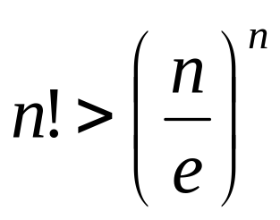
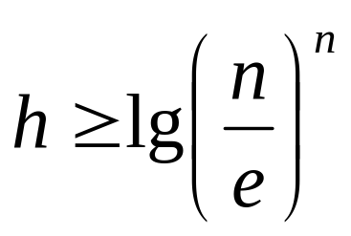
Lower Bound For
Comparison Sorting
So we have…
n! ≤ 2^{h}
Taking logarithms:
lg (n!) ≤ h
Stirling’s approximation tells us:
Thus:

Slide 78
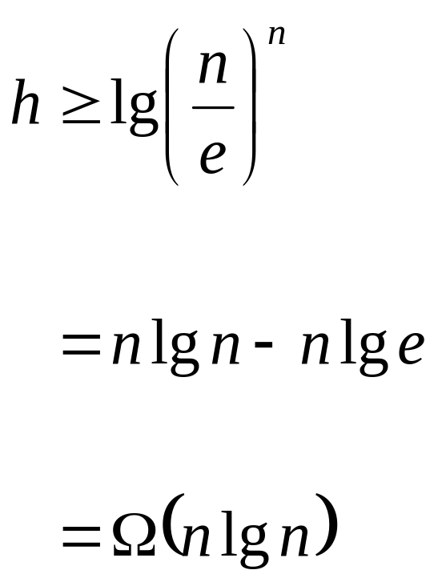
Lower Bound For
Comparison Sorting
So we have
Thus the minimum height of a decision tree is Ω(n lg n)

Slide 79
Lower Bound For
Comparison Sorts
Thus the time to comparison sort n elements is Ω(n lg n)
Corollary: Heapsort and Mergesort are asymptotically optimal comparison sorts
But the name of this lecture is “Sorting in linear time”!
  How can we do better than Ω(n lg n)?

Slide 80
Sorting In Linear Time
Counting sort
  No comparisons between elements!
  But…depends on assumption about the numbers being sorted
    We assume numbers are in the range 1.. k
  The algorithm:
    Input: A[1..n], where A[j] ∈ {1, 2, 3, …, k}
    Output: B[1..n], sorted (notice: not sorting in place)
    Also: Array C[1..k] for auxiliary storage

Slide 81
Counting Sort
1 CountingSort(A, B, k)
2 for i=1 to k
3 C[i]= 0;
4 for j=1 to n
5 C[A[j]] += 1;
6 for i=2 to k
7 C[i] = C[i] + C[i-1];
8 for j=n downto 1
9 B[C[A[j]]] = A[j];
10 C[A[j]] -= 1;
Work through example: A={4 1 3 4 3}, k = 4

Slide 82
Counting Sort
1 CountingSort(A, B, k)
2 for i=1 to k
3 C[i]= 0;
4 for j=1 to n
5 C[A[j]] += 1;
6 for i=2 to k
7 C[i] = C[i] + C[i-1];
8 for j=n downto 1
9 B[C[A[j]]] = A[j];
10 C[A[j]] -= 1;
Takes time O(k)
Takes time O(n)
What will be the running time?

Slide 83
Counting Sort
Total time: O(n + k)
  Usually, k = O(n)
  Thus counting sort runs in O(n) time
But sorting is Ω(n lg n)!
  No contradiction--this is not a comparison sort (in fact, there are no comparisons at all!)
  Notice that this algorithm is stable

Slide 84
Counting Sort
Cool! Why don’t we always use counting sort?
Because it depends on range k of elements
Could we use counting sort to sort 32 bit integers? Why or why not?
Answer: no, k too large (2³² = 4,294,967,296)

Slide 85
Counting Sort
How did IBM get rich originally?
Answer: punched card readers for census tabulation in early 1900’s.
  In particular, a card sorter that could sort cards into different bins
    Each column can be punched in 12 places
    Decimal digits use 10 places
  Problem: only one column can be sorted on at a time

Slide 86
Radix Sort
Intuitively, you might sort on the most significant digit, then the second msd, etc.
Problem: lots of intermediate piles of cards (read: scratch arrays) to keep track of
Key idea: sort the least significant digit first
  RadixSort(A, d)
  for i=1 to d
  StableSort(A) on digit i
  Example: Fig 9.3

Slide 87
Radix Sort
Can we prove it will work?
Sketch of an inductive argument (induction on the number of passes):
  Assume lower-order digits {j: j<i}are sorted
  Show that sorting next digit i leaves array correctly sorted
    If two digits at position i are different, ordering numbers by that digit is correct (lower-order digits irrelevant)
    If they are the same, numbers are already sorted on the lower-order digits. Since we use a stable sort, the numbers stay in the right order

Slide 88
Radix Sort
What sort will we use to sort on digits?
Counting sort is obvious choice:
  Sort n numbers on digits that range from 1..k
  Time: O(n + k)
Each pass over n numbers with d digits takes time O(n+k), so total time O(dn+dk)
  When d is constant and k=O(n), takes O(n) time
How many bits in a computer word?

Slide 89
Radix Sort
Problem: sort 1 million 64-bit numbers
  Treat as four-digit radix 2¹⁶ numbers
  Can sort in just four passes with radix sort!
Compares well with typical O(n lg n) comparison sort
  Requires approx lg n = 20 operations per number being sorted
So why would we ever use anything but radix sort?

Slide 90
Radix Sort
In general, radix sort based on counting sort is
  Fast
  Asymptotically fast (i.e., O(n))
  Simple to code
  A good choice
To think about: Can radix sort be used on floating-point numbers?

Slide 91
Review: Radix Sort
How did IBM get rich originally?
Answer: punched card readers for census tabulation in early 1900’s.
  In particular, a card sorter that could sort cards into different bins
    Each column can be punched in 12 places
    Decimal digits use 10 places
  Problem: only one column can be sorted on at a time

Slide 92
Radix Sort
What sort will we use to sort on digits?
Counting sort is obvious choice:
  Sort n numbers on digits that range from 1..k
  Time: O(n + k)
Each pass over n numbers with d digits takes time O(n+k), so total time O(dn+dk)
  When d is constant and k=O(n), takes O(n) time
How many bits in a computer word?

Slide 93
Radix Sort
Problem: sort 1 million 64-bit numbers
  Treat as four-digit radix 2¹⁶ numbers
  Can sort in just four passes with radix sort!
Compares well with typical O(n lg n) comparison sort
  Requires approx lg n = 20 operations per number being sorted
So why would we ever use anything but radix sort?

Slide 94
Radix Sort
In general, radix sort based on counting sort is
  Fast
  Asymptotically fast (i.e., O(n))
  Simple to code
  A good choice
To think about: Can radix sort be used on floating-point numbers?

Slide 95
Summary: Radix Sort
Radix sort:
  Assumption: input has d digits ranging from 0 to k
  Basic idea:
    Sort elements by digit starting with least significant
    Use a stable sort (like counting sort) for each stage
  Each pass over n numbers with d digits takes time O(n+k), so total time O(dn+dk)
    When d is constant and k=O(n), takes O(n) time
  Fast! Stable! Simple!
  Doesn’t sort in place

Slide 96
Bucket Sort
Bucket sort
  Assumption: input is n reals from [0, 1)
  Basic idea:
    Create n linked lists (buckets) to divide interval [0,1) into subintervals of size 1/n
    Add each input element to appropriate bucket and sort buckets with insertion sort
  Uniform input distribution → O(1) bucket size
    Therefore the expected total time is O(n)
  These ideas will return when you will see hash tables (not in this course)

Slide 97
Order Statistics
The ith order statistic in a set of n elements is the ith smallest element
The minimum is thus the 1st order statistic
The maximum is (duh) the nth order statistic
The median is the n/2 order statistic
  If n is even, there are 2 medians
How can we calculate order statistics?
What is the running time?

Slide 98
Order Statistics
How many comparisons are needed to find the minimum element in a set? The maximum?
Can we find the minimum and maximum with less than twice the cost?
Yes:
  Walk through elements by pairs
    Compare each element in pair to the other
    Compare the largest to maximum, smallest to minimum
  Total cost: 3 comparisons per 2 elements = O(3n/2)

Slide 99
Finding Order Statistics:
The Selection Problem
A more interesting problem is selection: finding the ith smallest element of a set
We will show:
  A practical randomized algorithm with O(n) expected running time
  A cool algorithm of theoretical interest only with O(n) worst-case running time

Slide 100
Randomized Selection
Key idea: use partition() from quicksort
  But, only need to examine one subarray
  This savings shows up in running time: O(n)
We will again use a slightly different partition than the book:
  q = RandomizedPartition(A, p, r)
≤ A[q]
≥ A[q]
p
q
r

Slide 101
Randomized Selection
RandomizedSelect(A, p, r, i)
if (p == r) then return A[p];
q = RandomizedPartition(A, p, r)
k = q - p + 1;
if (i == k) then return A[q]; // not in book
if (i < k) then
return RandomizedSelect(A, p, q-1, i);
else
return RandomizedSelect(A, q+1, r, i-k);
k
≤ A[q]
≥ A[q]
p
q
r

Slide 102
Randomized Selection
Analyzing RandomizedSelect()
  Worst case: partition always 0:n-1
    T(n) = T(n-1) + O(n) = ???
    = O(n²) (arithmetic series)
    No better than sorting!
  “Best” case: suppose a 9:1 partition
    T(n) = T(9n/10) + O(n) = ???
    = O(n) (Master Theorem, case 3)
    Better than sorting!
    What if this had been a 99:1 split?

Slide 103
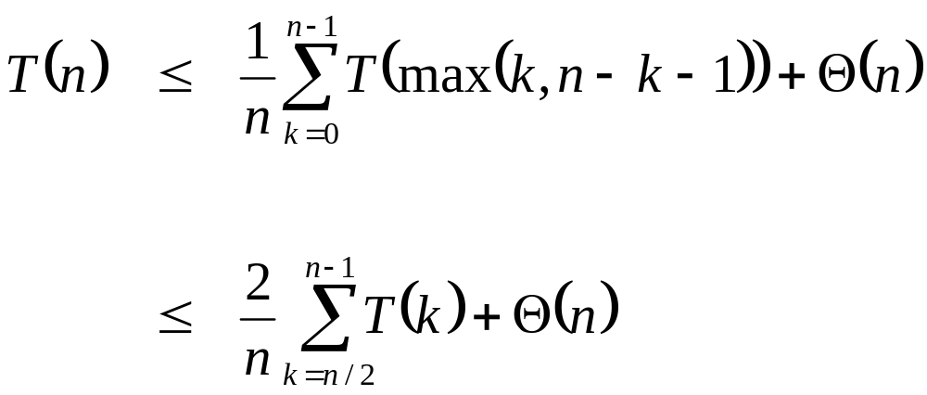
Randomized Selection
Average case
  For upper bound, assume ith element always falls in larger side of partition:
  Let’s show that T(n) = O(n) by substitution
What happened here?

Slide 104
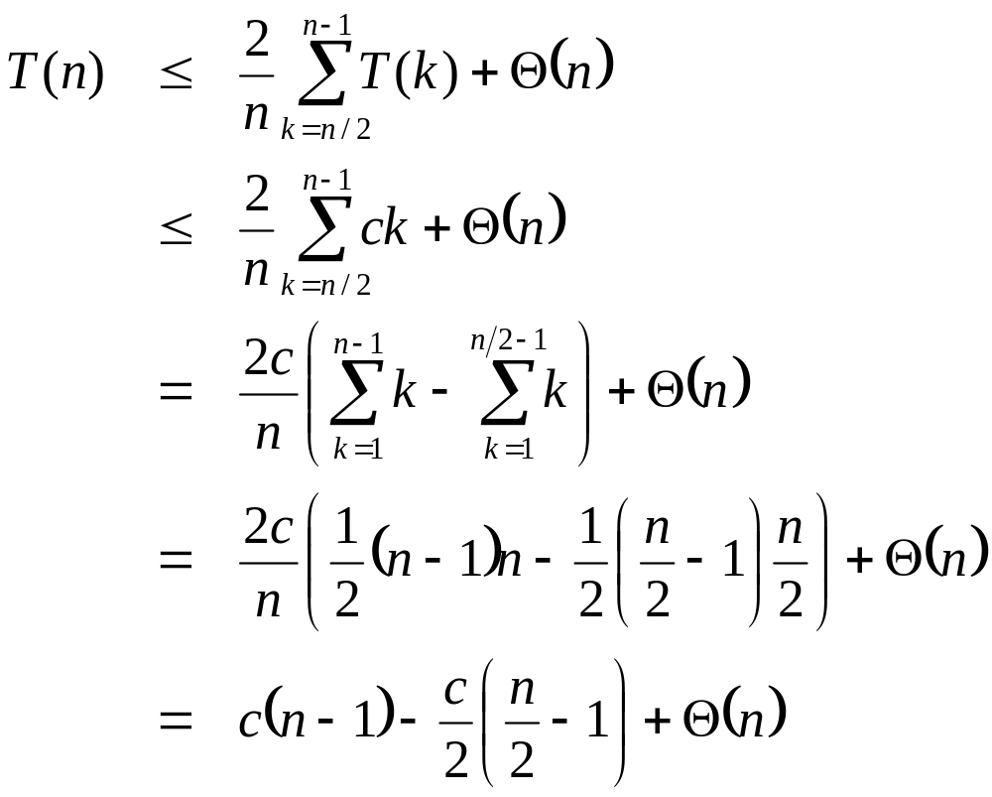
Randomized Selection
Assume T(n) ≤ cn for sufficiently large c:
The recurrence we started with
What happened here?
Substitute T(n) ≤ cn for T(k)
What happened here?
“Split” the recurrence
Expand arithmetic series
What happened here?
What happened here?
Multiply it out

Slide 105
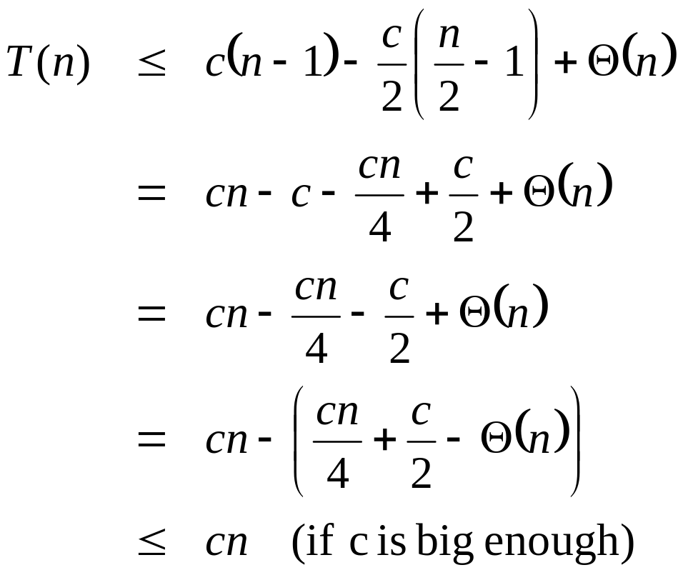
Randomized Selection
Assume T(n) ≤ cn for sufficiently large c:
The recurrence so far
What happened here?
Multiply it out
What happened here?
Subtract c/2
What happened here?
Rearrange the arithmetic
What happened here?
What we set out to prove

Slide 106
Worst-Case Linear-Time Selection
Randomized algorithm works well in practice
What follows is a worst-case linear time algorithm, really of theoretical interest only
Basic idea:
  Generate a good partitioning element
  Call this element x

Slide 107
Worst-Case Linear-Time Selection
The algorithm in words:
  1. Divide n elements into groups of 5
  2. Find median of each group (How? How long?)
  3. Use Select() recursively to find median x of the ⎣n/5⎦ medians
  4. Partition the n elements around x. Let k = rank(x)
  5. if (i == k) then return x
  if (i < k) then use Select() recursively to find ith smallest element in first partition
  else (i > k) use Select() recursively to find (i-k)th smallest element in last partition

Slide 108
Worst-Case Linear-Time Selection
(Sketch situation on the board)
How many of the 5-element medians are ≤ x?
  At least 1/2 of the medians = ⎣⎣n/5⎦ / 2⎦ = ⎣n/10⎦
How many elements are ≤ x?
  At least 3 ⎣n/10 ⎦ elements
For large n, 3 ⎣n/10 ⎦ ≥ n/4 (How large?)
So at least n/4 elements ≤ x
Similarly: at least n/4 elements ≥ x

Slide 109
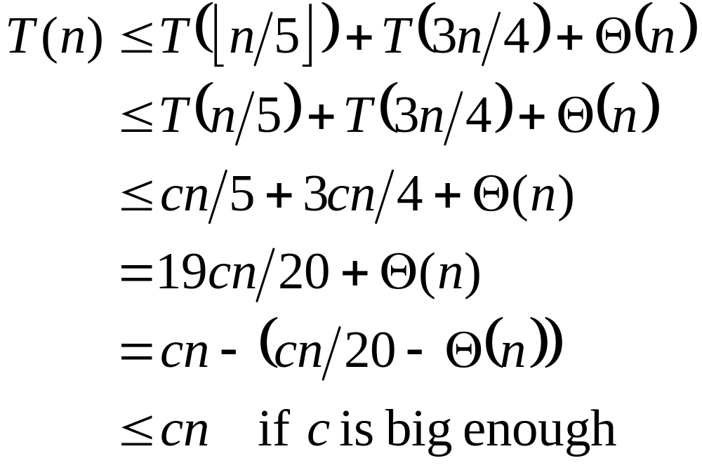
Worst-Case Linear-Time Selection
After partitioning around x, step 5 will call Select() on <= 3n/4 elements
The recurrence is therefore:
Substitute T(n) = cn
Combine fractions
Express in desired form
What we set out to prove

Slide 110
Worst-Case Linear-Time Selection
Intuitively:
  Work at each level is a constant fraction (19/20) smaller
    Geometric progression!
  Thus the O(n) work at the root dominates

Slide 111
Linear-Time Median Selection
Given a “black box” O(n) median algorithm, what can we do?
  ith order statistic:
    Find median x
    Partition input around x
    if (i ≤ (n+1)/2) recursively find ith element of first half
    else find (i - (n+1)/2)th element in second half
    T(n) = T(n/2) + O(n) = O(n)
  Can you think of an application to sorting?

Slide 112
Linear-Time Median Selection
Worst-case O(n lg n) quicksort
  Find median x and partition around it
  Recursively quicksort two halves
  T(n) = 2T(n/2) + O(n) = O(n lg n)

Slide 113
So ....
We're done with sorting (phew!)
From now on work on more general problems
Concentrate on alg. design techniques
Next on the agenda: Greedy Algorithms.

